Slide 1


BIKE SHARING DEMAND ANALYSIS
- BY
D.JANANI SRI
PROJECT- NEXTHIKES IT SOLUTIONS

Slide 2
PROJECT OBJECTIVES →
Analyse Bike Sharing Demand According Seasonal Basis.
Bike Rentals Are Analysed By Time, Hours , Weekdays ,Weekends and Holidays.
Analysing the Weather Impact by Windspeed , Temperature , Humidity .
Cleaning->Merging->Appending->Final Pre-processed Dataset.
Applying The Basic Formulae : SUM,AVERAGE,COUNT,MAX,MIN
Using IF Conditions, Look Ups Value , Conditional Formatting , Index and Match.
Pivot Table and Charts according to the Demands On Bike Rentals , based on the Weather sit And Holidays.
Building an Interactive Dashboard with KPI’s , Pivot Charts with Slicers and Timelines.
Using the Advanced descriptive Statistics, Correlation Analysis, Forecasting and Anomaly Detections helps the Planning of business according to the Demands.

Slide 3
DATA INTEGRATION AND WORKFLOW →
Dataset_1 : Bike Rentals and Users Data After Data Cleaning , Handling the Missing Values , Removing the Duplicates, Pre-processed Consistent and Corrected Data Type containing Headers Date, Season, Year, Month, Hour, Holidays, Weekdays, Weather sit and Temperature.
Dataset_2 : Bike Rentals and Users Data After Data Cleaning , Handling the Missing Values , Removing the Duplicates, Pre-processed Consistent and Corrected Data Type containing Headers Assumed Temperature, Windspeed, Humidity, Registered Users, Casual Users and Total Count of the Users, also Predicts the relative Demands of the Rentals According to the Weather Impact .
Dataset A :Merging Cleaned and Pre-Processed Dataset_1 + Dataset_2 from the Period Of Jan01st 2011 to Jan28th 2011.
Dataset_3 : Cleaned and Pre-Processed data from the Period of Jan 28th 2011 to Feb 14th 2011 with Count of 390.
Final Dataset : Appending the Cleaned and Pre-Processed Dataset A +Dataset_3 with all the factors under Weather & Users Type.

Slide 4
FINAL_DATASET →
Date :
Jan 1st 2011 –
Feb 14th 2011
Season : 1
Year : 0
Month : 1 & 2
Weekdays :
0 – 6
Holiday : True
Weekdays :
False
Weather sit :
1 , 2 , 3 , 4
Average Humidity :
3.6313
Average Actual Temp :
0.2059
Average Assumed Temp :
0.2096
Average Hours :
11.753
Average Windspeed :
0.1949
Registered Users :
53383
Total Users :
58304
Casual Users :
4921

Slide 5
Monthly Demand users →
Monthly Demand User Wise , Also the Linear Trendline Shows Total Customers Through Out the Period Is Flat At Study Rate.

Slide 6
AVERAGE CASUAL & REGISTERED USERS BY WEEKDAYS →
As per Weekdays Predictions the no. of Registered Customers is high compared with the casual customers.

Slide 7
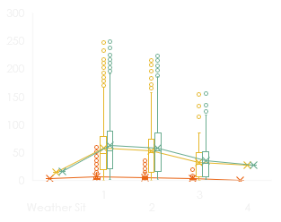
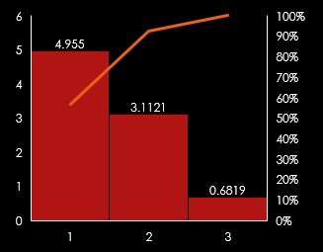
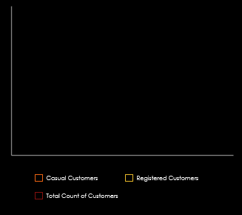
WEATHER IMPACTS →
WEATHER VS TEMPRATURE
WEATHER VS USERS
WEATHER VS WEEKDAYS COUNT
Temp gradually falls as weather is too rainy.
The users works only on Wednesday when the weather is too rainy where as works on all the days for the other 3 climatic conditions.
The sum of working days is high in good weather condition where as gradually falls down as the weather falls too rainy.

Slide 8
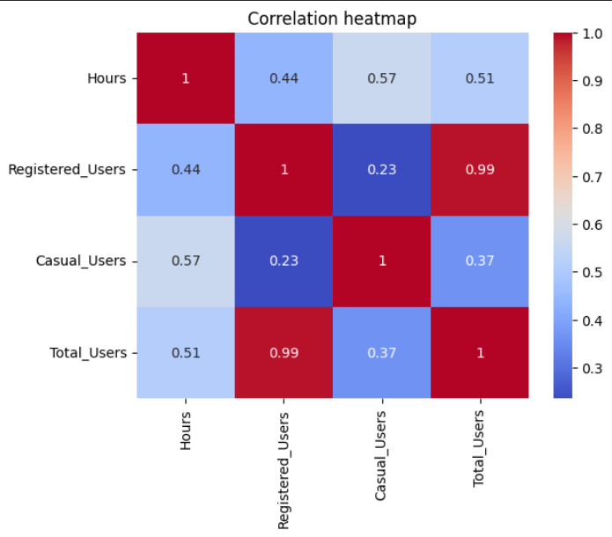
CORRELATION MATRIX →Bike rentals (casual, registered, and total) change over time (hours), showing that registered users overwhelmingly drive total rental volume.
Total Users vs. Registered Users (0.988)
Strongest Relationship: Registered users are the main drivers of total rental volume.
Hours vs. Casual Users (0.566) & Total Users (0.513)
Moderate Relationship: There is a clear connection between the time of day and bike usage.
Hours vs. Registered Users (0.439)
Moderate-to-Weak Relationship: Lower impact on registered users compared to casual users.
Casual Users vs. Total Users (0.365)
Weak Relationship: Changes in casual users do not strongly track with changes in total users.
Registered Users vs. Casual Users (0.235)
Weakest Relationship: Behaviour of registered riders and casual riders is mostly independent.

Slide 9
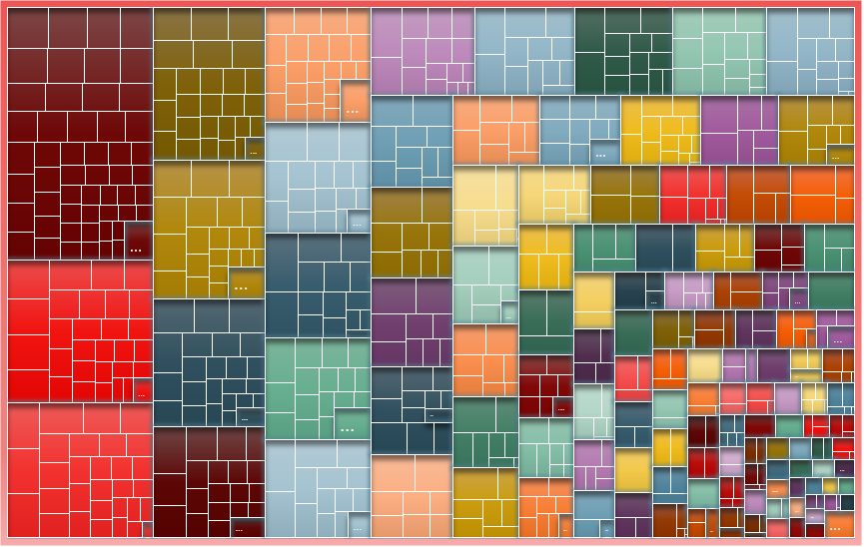
Total Count of Customers based on a hierarchy of contributing factors: Weather Situation, Month, and Day Type →
The Main Metric: The size (and often colour) of the rectangles represents the volume of customers.
The Categorical Drivers: The nested structure breaks down exactly which combinations of weather, time of year, and day types yield the highest or lowest customer traffic.

Slide 10
INTERACTIVE DASHBOARDS →
It uses Dynamic Data Visualizations and Business Intelligence to describe the Components , Features and Data Structures.
Core Dashboard Elements →
A single consolidate screen view displaying .
4 to 5 Interactive and Highlighting KPI – Key Performance Indicators
Line Chart , Bar Graphs , Pivot Charts
Slicers – A visible on screen panel or button control used to filter table and chart data by specific categories.
Parameter controls or Timeline Slicers : Interactive widgets the lets to adjust date ranges , variables or thresholds dynamically.
Forecasting charts are also added .
These filters are also known as Interactive and Analytical Functions of the Dashboards.

Slide 11
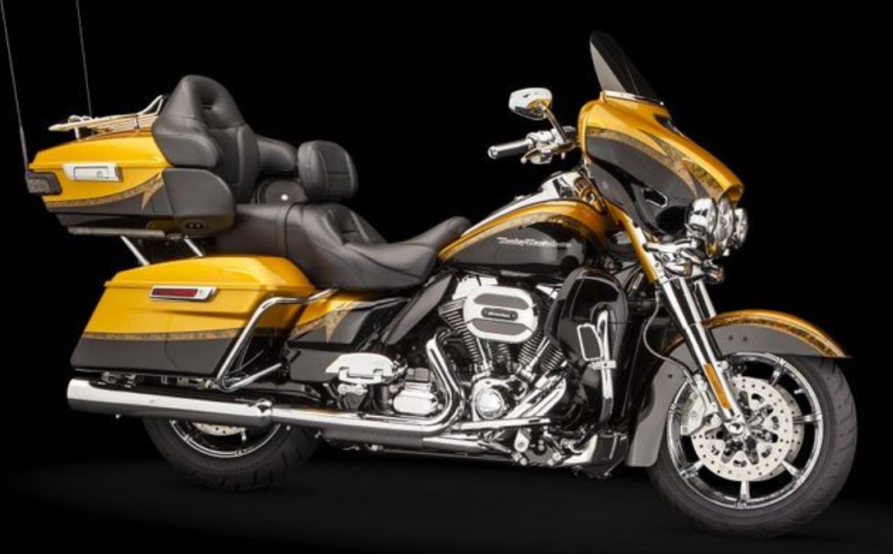





DASHBORAD ELEMENTS →
BIKE RENTALS DEMAND ANALYSIS
TOTAL DEMAND RENTAL VOLUME -58304
REGISTERED USERS-53383
CASUAL USERS-
4921
TEMPERATURE PROGRESS-
99.64%
HOURLY DEMAND-
58.30
AVERAGE HUMIDITY -
3.6313

Slide 12
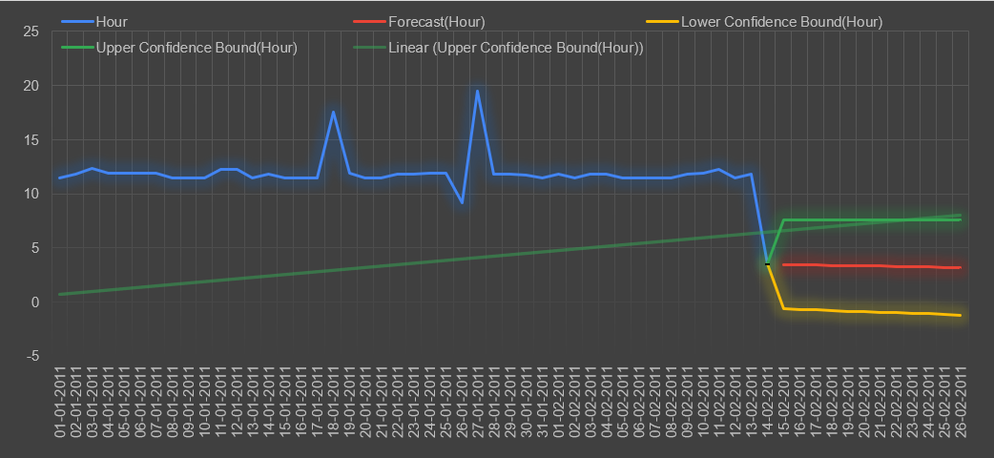
Forecasting & Anomaly Detections →

Slide 13
FORECASTING SHEET CONCLUSIONS →
Forecast sheet tracks an hourly metric over January and February 2011 to project future values.
From Jan 1st to Feb 13th , the metric consistently oscillates around a baseline of 11 to 12 hours.
Around Feb 14th it drops sharply to approximately for 3.5 hours.
Forecast (red line) projects that the metric will completely lose its baseline values.
The Yellow Line (Lower Confidence Bound) dips below zero into negative territory .
Anomalies Identifications :
Jan 18th Spike : The metric jumps from its baseline upto 17.5 hours before immediately returning to the normal next day.
Jan 26th Drop : A sharp single day dip down to 9 hours
Jan 27th Peak : Following the dip , the metric spikes to its highest point 19.5 Hours the Peak before stabilizing to the Jan 28th. [HIGHEST ANAMOLY]
Feb 14th structural shift : Unlike the temporary spikes in Jan , the drop on Feb 14th is permanent structural break .

Slide 14
VBA AUTOMATIONS →
Visual Basic for Applications (VBA) is Microsoft's event-driven programming language.
It is built directly into Microsoft Office programs like Excel, Word, PowerPoint, Outlook, and Access.
It automates repetitive tasks, builds custom functions (UDFs), and extends the capabilities of host applications.
Key Features
I Object-Oriented Basics
II Macro Recording
III Editor Access
IV File Format

Slide 15
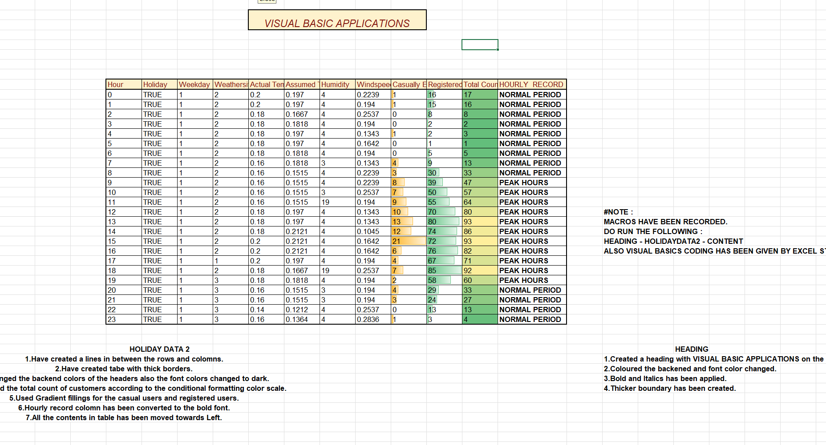
SIMPLE MACRO RECORDINGS →
VBA DONE WITH BASICS FORMATTING THE CELLS AND APPLYING THE COLOR SCALES.
ALSO HEADING IS GIVEN THROUGH VBA.
CONTENTS ARE ALSO SAVED.
RUN-HEADING-HOLIDAYDATA-CONTENT.

Slide 16
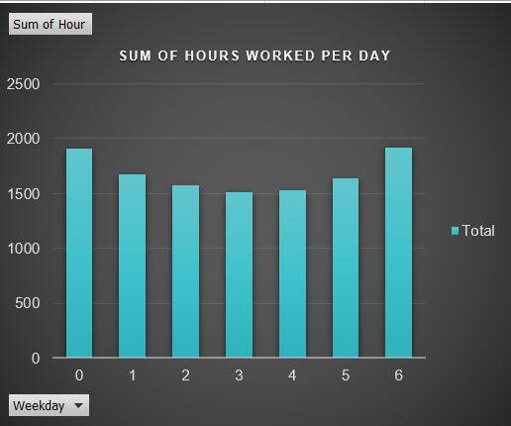
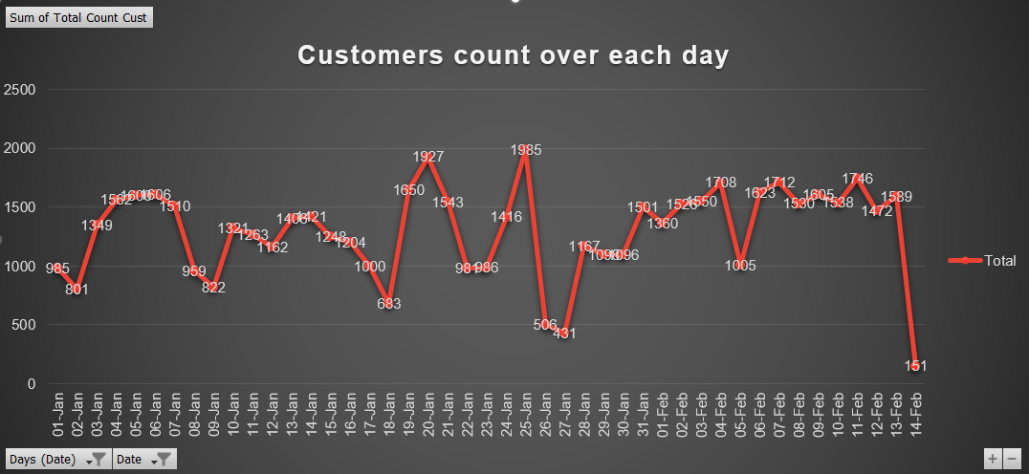
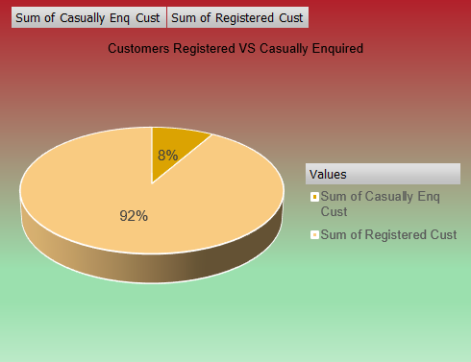
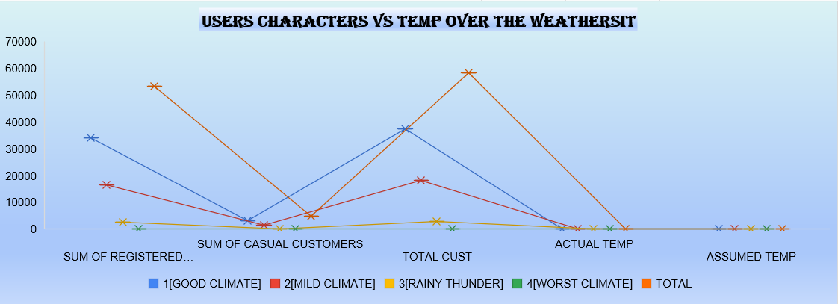
VISUAL CHARTS →

Slide 17
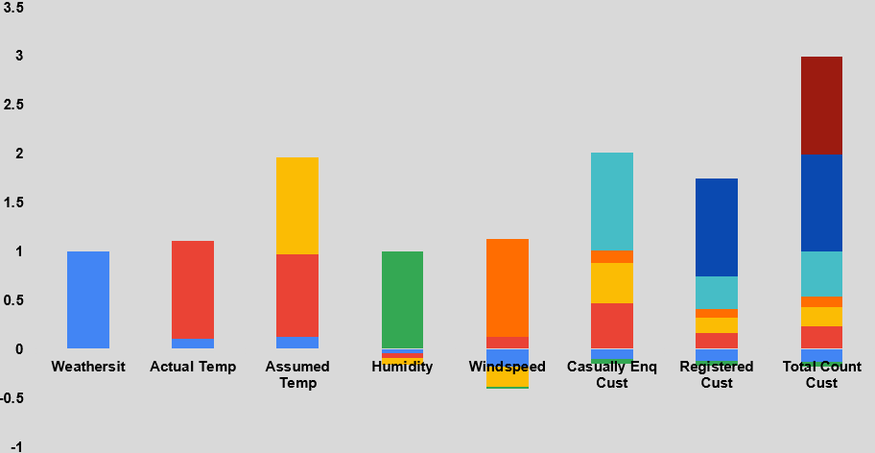
CORREATION ANALYSIS BETWEEN THE USERS AND THE WEATHER ELEMENTS →
Correlation analysis to predict the relationships between weather conditions, temperature, humidity, windspeed, casual customers, registered customers and total customer count.
Statistical Visualizations :
Registered customers
r = 0.990
Very closely associated with total demand.
Actual temperature
r = 0.229
Shows a weak positive relationship with total demand but a stronger relationship with casual demand.
Weather, humidity and windspeed
These variables have weak correlations with total demand in your matrix. They may still contribute to forecasting when combined with time, seasonality, holidays and other variables.

Slide 18
Interpretations →
A. Customer demand analysis
Registered customers and total customers (0.990): An extremely strong positive correlation.
Casual customers and total customers (0.467): Moderate positive relationship.
Casual customers and registered customers (0.338): A weak-to-moderate positive relationship.
B. Temperature analysis
Actual temperature and assumed temperature (0.837):A strong positive relationship.
Actual temperature and casual customers (0.470): Moderate positive relationship.
Assumed temperature and casual customers (0.407):Moderate positive relationship.
Actual temperature and total customers (0.229): The relationship is weakly positive.
C. Weather conditions analysis
Weather sit and total customers (-0.126): A weak negative relationship suggests that higher weather-condition codes are associated with slightly lower customer counts.
Humidity and total customers (-0.050): The correlation is close to zero, indicating almost no linear relationship.
Windspeed and total customers (0.104): A very weak positive relationship.
Variable relationship | Correlation | Interpretation
Registered Cust ↔ Total Count Cust | 0.990 | Extremely strong positive correlation
Actual Temp ↔ Assumed Temp | 0.837 | Strong positive correlation
Actual Temp ↔ Casually Enq Cust | 0.470 | Moderate positive correlation
Assumed Temp ↔ Casually Enq Cust | 0.407 | Moderate positive correlation
Casually Enq Cust ↔ Total Count Cust | 0.467 | Moderate positive correlation
Casually Enq Cust ↔ Registered Cust | 0.338 | Weak-to-moderate positive correlation
Windspeed ↔ Assumed Temp | -0.210 | Weak negative correlation
Weathersit ↔ Total Count Cust | -0.126 | Weak negative correlation
Humidity ↔ Total Count Cust | -0.050 | Very weak negative correlation

Slide 19
RESULTS & RECOMMENDATIONS→
Total highest rentals falls on the Clear and Good Climate.
Peak Demand Hours in data is around 5 PM.
More Bike availability can be given in the Peak Hours.
As per the weather conditions plan the fleet availability accordingly.
Datasets reigns over the historical periods.
Clear Weather has the highest total rental.
Planning has to be done on the basis of Weather Conditions.
The Bike Rentals Demand is Changing Dominantly on the Basis of Time , Weather Conditions and the Types of Customers.
Highest Demand is around 5PM – 6 PM .
Actual Temperature And Assumed Temperature is associated comparatively higher rental demand , as very low and high temperature values shows lower activity.
Windspeed is inversely proportional to the bike rental activities.
Major and Dominant Conclusion from this historical data is “The Registered Users are the Major Part of the Bike rentals activities compared with the Casual Users”.
Tools Used : Excel , Power Querry , Pivot table and charts , Dashboards , Forecasting , Anomaly Detections , Correlation Analysis , VBA.

Slide 20
THANK YOU

